Slide 1
HyDRO : Harvesting-aware Data Routing for
Underwater Wireless Sensor Networks
小组成员：王晨，傅彦钧，李可，徐咏晴

Slide 2
Contents
1.Motivation
2. Models
3. Implementation
4.Results

Slide 3
Contribution
○ Code： 王晨，傅彦钧
○ Simulate: 李可
○ Paper, Presentation: 徐咏晴

Slide 4
1
Motivation

Slide 5
Motivation
With rapid development of science and technology, communication has become more and more convenient. However, underwater communication is still yet to be developed.
The original paper is Harnessing HyDRO: Harvesting-aware Data ROuting for Underwater Wireless Sensor Networks (Mobihoc 2018)
Keywords: Routing Protocol, Underwater Wireless Sensor Networks (UWSNs) , Underwater wireless communication, Energy harvesting, Reinforcement learning, Q-learning, Ns2

Slide 6
2
Models

Slide 7
Models
● Energy-harvesting Model
○ Q-learning based reinforcement learning Model

Slide 8
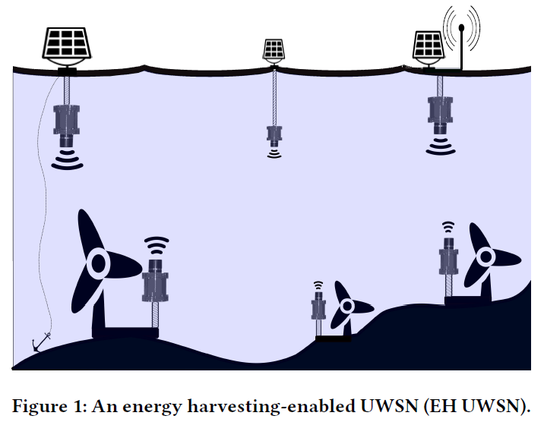
Energy-harvesting Model
○ closer - - solar energy (panels)
○ deeper- - kinetic energy (turbines)
○ sink node
○ all-off node

Slide 9
Models
○ Energy-harvesting Model
● Q-learning based reinforcement learning Model

Slide 10
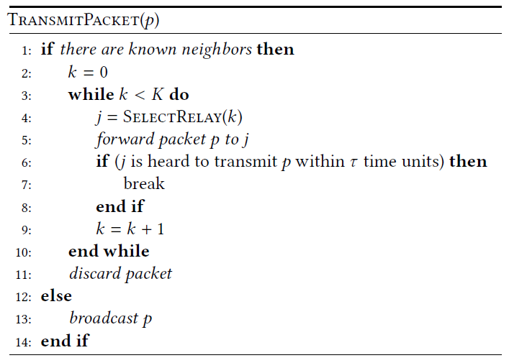
Q-learning based Model
○ Implicit ACK
○ τ is a pre-determined amount of time
○ K is the maximum time of attempts to transmit packet

Slide 11
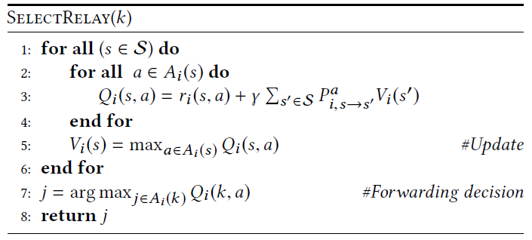
Q-learning based Model

Slide 12






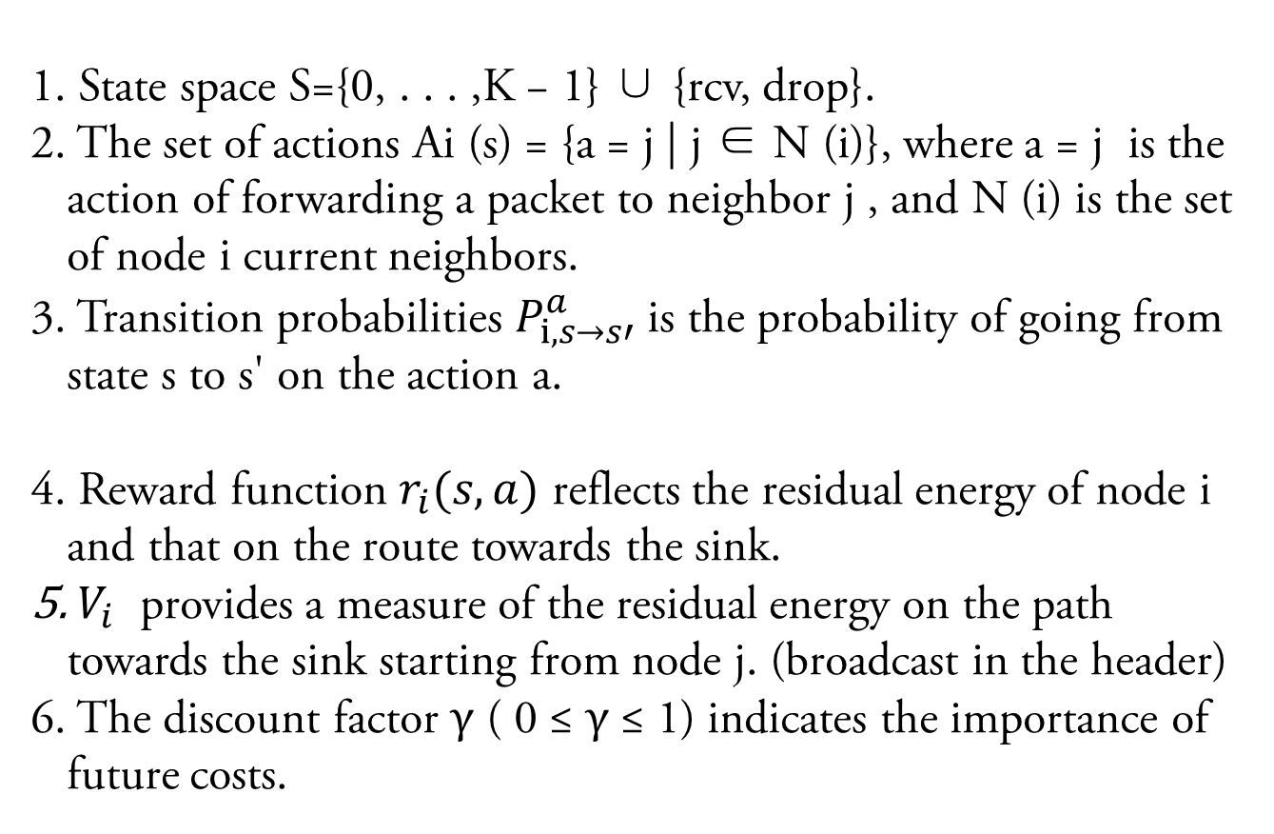
Q-learning based Model
State space S={0, . . . ,K − 1} ∪ {rcv, drop}.
The set of actions Ai (s) = {a = j | j ∈ N (i)}, where a = j is the action of forwarding a packet to neighbor j , and N (i) is the set of node i current neighbors.
Transition probabilities $P_{i, s→s′}^{a}$ is the probability of going from state s to s' on the action a.
Reward function $r_{i}(s,a)$ reflects the residual energy of node i and that on the route towards the sink.
${ V}_{i}$ provides a measure of the residual energy on the path towards the sink starting from node j. (broadcast in the header)
The discount factor γ ( 0 ≤ γ ≤ 1) indicates the importance of future costs.

Slide 13
3
Implementation

Slide 14
Flow Chart

Slide 15
Challenges
○ Some details are not clearly described in the paper. Eg. It’s not clear that how to update V(rcv) and V(drop).
○ We do not have a suitable platform to implement our routing algorithms. The SUNSET mentioned in the paper is not downloadable so we need to build our own simulators.
○ The origin simulator last six days, but we do not have the conditions. So we have to reset the parameters.

Slide 16
Methods we have tried
○ Building Wireless Sensor Network Simulator using C++ from scratch, we have realized the communication function between two nodes, and implement routing algorithm based on it.
○ Send e-mails to all authors, but no one replies. So we consult teachers and used our imaginations.
○ By experimenting with different parameters and adjusting assumptions based on unclear details, better results are obtained.

Slide 17
Multithread Programming
○ Considering each node as a thread, the communication between threads is used to simulate the information exchange between nodes.
○ A thread is used to generate data packets according to Poisson Distribution. When packet is generated, it is randomly added to the message queue of a node.
○ A thread is used to generate energy.

Slide 18
Simulation scenarios and metrics
Parameters | Value
Simulation duration | 20 min
Number of nodes | 20
Size of deployment area | 2 km²
Depth of deployment | From 10m to 240m
Bit Rate | 4000 b/s
Packet payload size | 1000 B
HyDRO header size | 15 B
Packet inter-arrival time | [5,4,3](low to high traffic)
Number of retransmissions K | [5,4,3](low to high traffic)
Discount factor γ | 0.95

Slide 19
Our improvements
○ In order to avoid self-looping, we only add those closer to the sink to the neighborhood table at first.
○ After receiving packets from a new node for the first time, its state would be relax. For the second time, it would be turned into active.

Slide 20
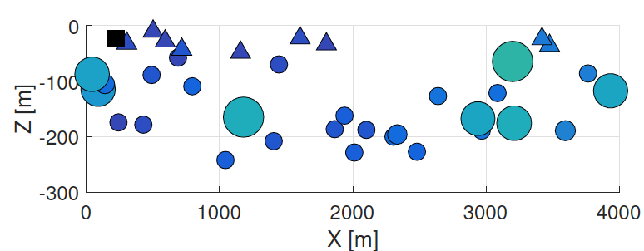
Energy harvesting traces and model
○ The solar panel is deployed on buoys at sea surface
○ Nodes deployed at depths greater than 50m draw power from a sea current turbine
○ Let's suppose half the time is in the dark.

Slide 21
4
Results

Slide 22
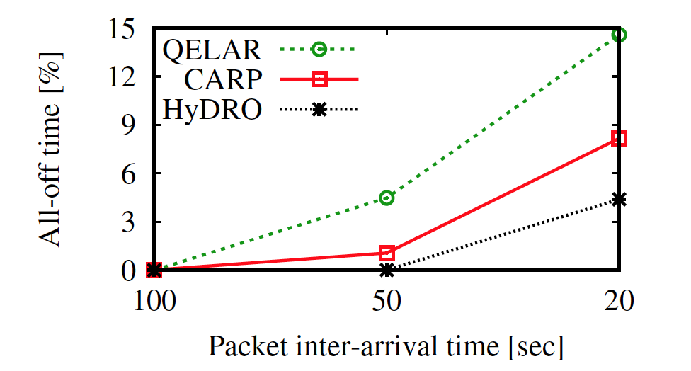
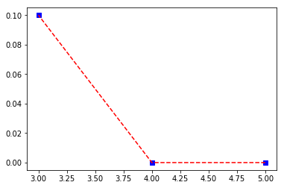
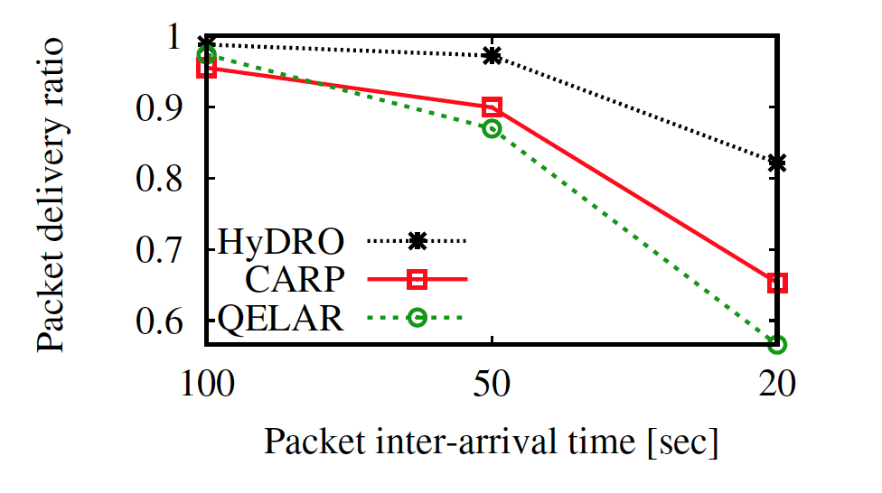
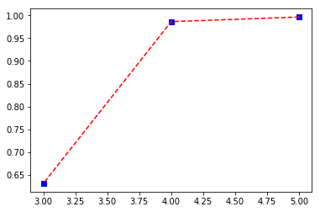
Result
There is a similar trend.

Slide 23
Result
○ The paper compares the results of the three models, but we only reproduce one of the best. So we need another way of comparison to prove the correctness of the model.
○ We compare the energy consumption of nodes at different locations during the day and night to prove that routing selection changes with energy changes.

Slide 24
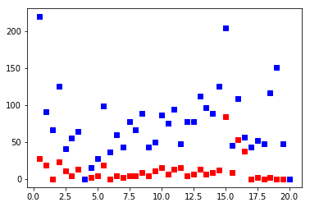
Result
○ 0-10 days, 10-20 nights. Nodes on the water surface do not generate energy at night
○ After a period of consumption, the routing choice of nodes changes.

Slide 25
Visualization by NS2
Node 0 connect: 2 3 6 8
Node 1 connect: 9
Node 2 connect: 1 6 8
Node 3 connect: 2 4
Node 4 connect: 1 2
Node 5 connect: 3 4
Node 6 connect: 1 8
Node 7 connect: 0 3 5
Node 8 connect: 1 9
node 9 is the sink node
only node 1 and 8 can transmit packet to the sink
maximum bit rate: 100kb
propagation delay: 1s
packet size: 1015
bitrate: 4k
simulation time: 5min

Slide 26
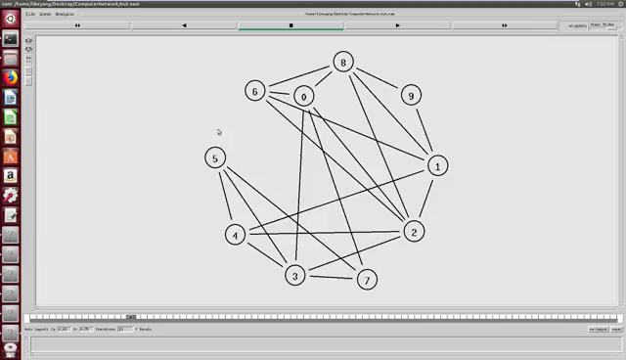
Visualization by NS2

Slide 27
Thanks
For
Watching

